Slide 1
Focus for the Day
Share highlights of mentoring experiences
Explore how observation and feedback can support and extend professional learning
Introduce a collaborative protocol for exploring student work
Strengthen and maintain momentum in the mentoring relationship
Discuss ongoing learning focus

Slide 2
The Newlywed game
1. ‘Alternate ‘ career?
2. Biggest pet peeve?
3. Teaching style most like a racehorse, a bear, or a beaver?
4. Most likely weekend activity?
5. A teaching strength?

Slide 3
How has a sense of place influenced your teaching and mentoring work?

Slide 4
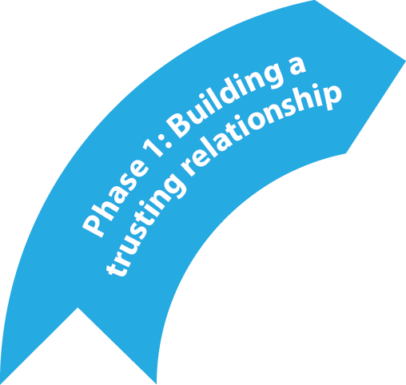
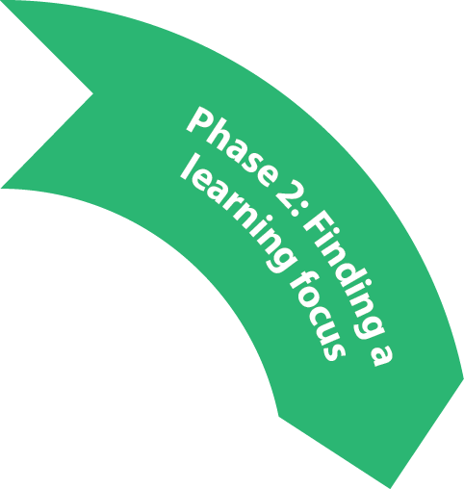
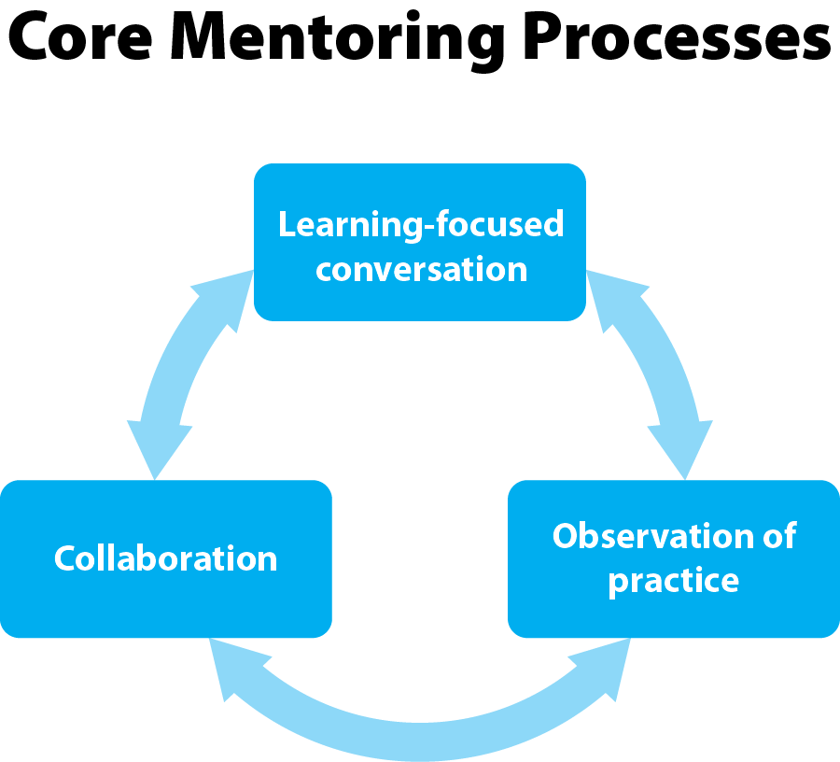
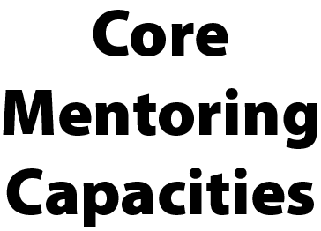

Slide 5
Give and Get
Find examples of what is working well in mentoring partnerships and record on the sheet provided
Return to your partner when you hear the signal and discuss highlights
Choose one interesting highlight to share with whole group

Slide 6
Enabling Growth: providing support, challenge and vision through effective feedback
vision
challenge
support

Slide 7
“The purpose of feedback is to improve conceptual understanding or increase strategic options while developing stamina, resilience, and motivation – expanding the vision of what is possible and how to get there.
Perhaps we should call it feedforward rather than feedback.”
P. Johnston, Opening Minds, p.48

Slide 8
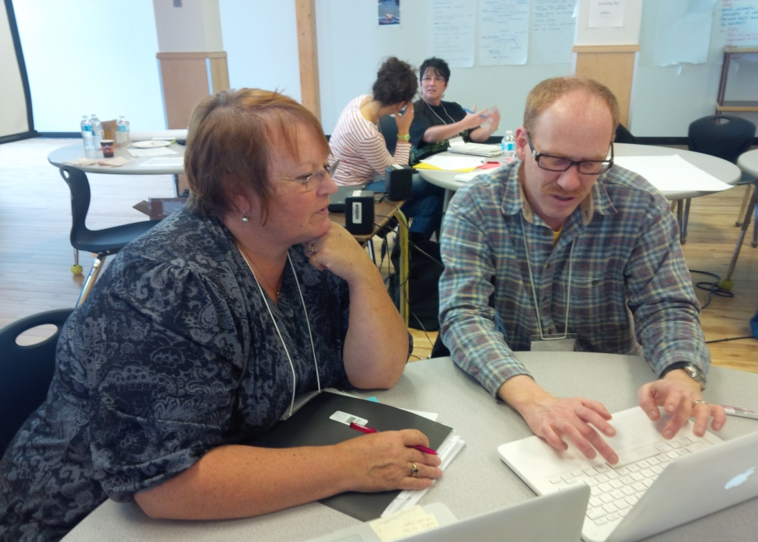
s
How can I give direct, honest feedback in ways that preserve the relationship, maintain openness and trust, and move practice forward?
Notes:
Discernment – the making of good judgments in context, rather than technical application of learning skills.

Slide 9
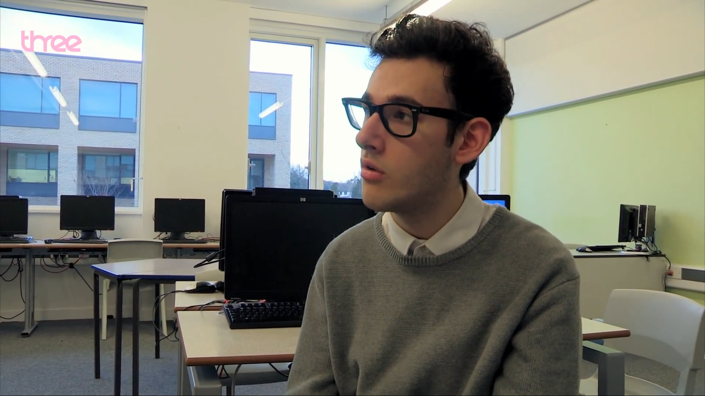
Mentoring—Reality TV: Oliver gets some negative feedback
Notes:
Mentoring—Reality TV: Oliver gets some negative feedback—Tough Young Teachers: Episode 2 preview—BBC Three
http://www.youtube.com/watch?v=2XKZKdJf6Fw

Slide 10
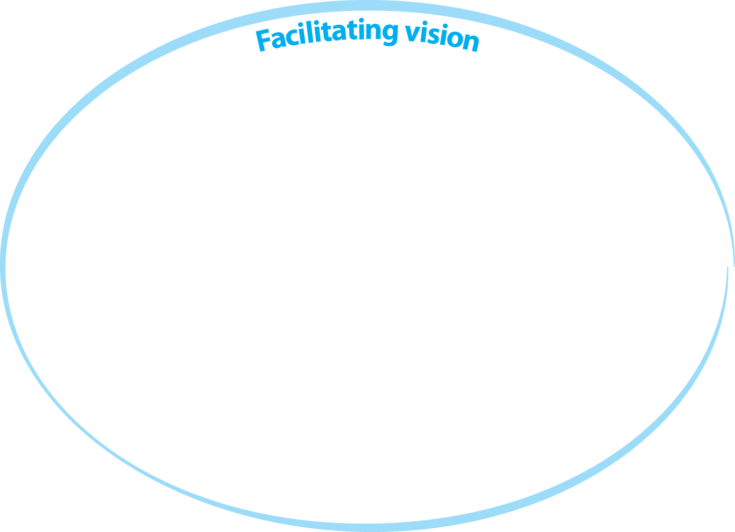
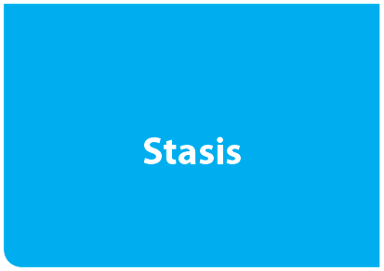

Slide 11
‘Decisional Capital’ Hargreaves and Fullan, Professional Capital, 2012
“The essence of professionalism is the ability to make discretionary judgments.”
“The capacity to judge and judge well depends
on the ability to make decisions in situations of unavoidable uncertainty when the evidence or the rules aren’t categorically clear. “

Slide 12
Wisdom is particularly important in order to capture that our educational actions are never just a repetition of what has happened in the past but are always radically open toward the future. We need judgment rather than recipes in order to be able to engage with this openness and do so in an educational way.
G. Biesta, The Beautiful Risk of Education, 2014

Slide 13
Criteria for giving useful feedback (Hal Portner, Mentoring New Teachers, Corwin Press)
Descriptive rather than evaluative
Specific rather than general
Takes into account the needs of both the receiver and giver of feedback
Directed towards behaviour that the receiver can do something about
Solicited, rather than imposed
Well-timed
Checked to ensure clear communication

Slide 14
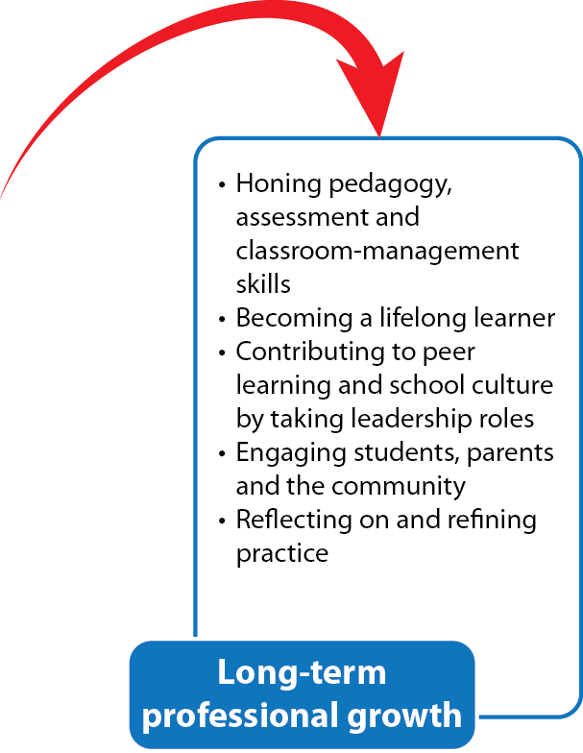
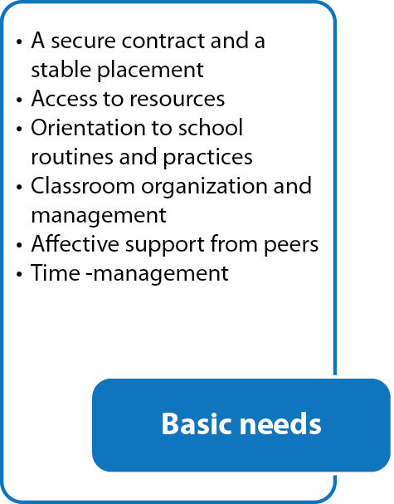
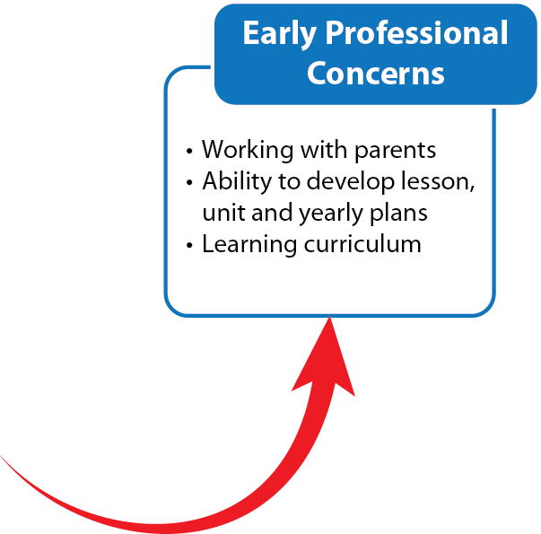
Evolving Professional Development Needs

Slide 15
Separate Groups
Mentees
Mentors
With respect to supporting your educational needs, what would you like more of, less of ? Please chart and bring back to whole group.
Criteria for Formative Growth – highlight and evidence areas of growth. Then highlight where you want to focus in your ongoing work.
Choose an area of focus from criteria for formative growth
Observe video
Discuss feedback using description, interpretation, and implication as a frame
Practice feedback conversation

Slide 16
Observation and Feedback Practice
With a partner, choose one element from Domain 1, 2 or 3 as your observational focus
Watching the video, note what you observe related to this element
Discuss observed data with your partner
Design some feedback questions relevant to describe, explore, and extend feedback conversation
Practice a post observation conversation taking on mentor/mentee roles

Slide 17
Video – Math Class
Grade 6 math class video observation
Please watch and record what you notice related to the criteria you have identified.

Slide 18
Description | Here’s what?
Interpretation | So what?
Implications | Now what?

Slide 19
Questions to Guide Feedback
Invite | describe confirm acknowledge engage activate
Explore | clarify probe interpret question cause/effect
Extend | connect action to theory challenge identify application define goals, direction
Questions that invite inquiry, and open up thinking. These questions help others to explore ideas, issues, concerns, perspectives, and proposals.
Questions which probe to focus thinking and encourage precision. These questions help to clarify vagueness and generalities.
Questions that extend thinking. These questions help others to connect to the bigger picture, to plan what action to take, to reconsider their ideas through a different lens or perspective.

Slide 20
Debrief Giving Feedback
Was professional judgment supported?
Do we have some new things to think about as a result of the conversation?

Slide 21
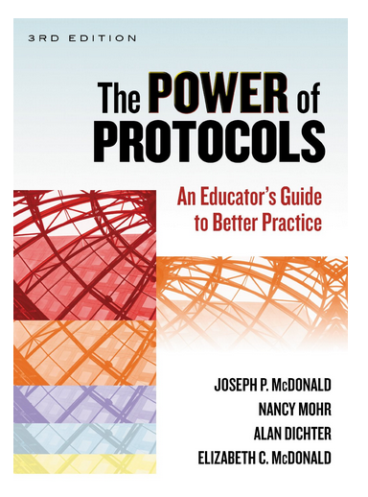
Collaboration – A protocol for exploring student work

Slide 22
Learning through constraints (from The Power of Protocols: An Educators’s Guide to Better Practice, 3rd Edition)
How to give and receive safe and honest feedback
How to analyze complex problems carefully without rushing to judgment
How to ground interpretations of student work through differing perspectives
“The idea is that under the right circumstances constraints are liberating”

Slide 23
Collaborative Assessment Conference
Purpose of this protocol is to:
Sharpen teachers’ perceptual skills by looking deeply at a single student’s work
Encourage a balance of perception
Help teachers see how they can act individually and collectively on what they learn in order to benefit their students

Slide 24
Mid year Discussion Guide
Using the prompts from the mid year discussion guide, discuss:
how its going with your partnership?
areas of growth?
areas for new or continuing focus?

