Slide 1
Learning-focused Conversations: building the toolkit

Slide 2
Learning-focused verbal tools
Paraphrasing
Logical levels: Multiple purposes
Acknowledge/clarify—calibrating content and emotions
Summarize/organize—a statement of themes, big ideas, and separation of confusing or jumbled issues
Shift Focus—a shift in logical level, raised to a category or conceptual label, or focused as a concrete example
Pausing
After asking a question
After receiving a response
While you frame your own
language
Learning-focused Verbal Tools
Pause
Paraphrase
Inquire
Probe
Extend
Inquiring
Without judging
Framed in a spirit of professional curiosity
Anticipates multiple possible responses
Invites thinking and meaning making
Extending
Making data available for making discoveries and developing shared understandings.
Giving information
Framing expectations
Providing resources
Probing
When there may be a lack of clarity or precision, in speech or thought, probe specifically regarding:
Who? What? Why? Where? When? How?
From: Laura Lipton and Bruce Wellmann
Mentoring Matters: A Practical Guide to Learning-focused Relationships
First Edition, March 2001, Sherman CT MiraVia, LLC

Slide 3
Learning-focused conversations
Confirm, clarify and extend thinking
help us to hear ourselves and others more accurately
Ask for full attentive presence to each other
allow us to listen attentively to multiple expressions of feeling and thought
help to frame problems rather than offer solutions

Slide 4

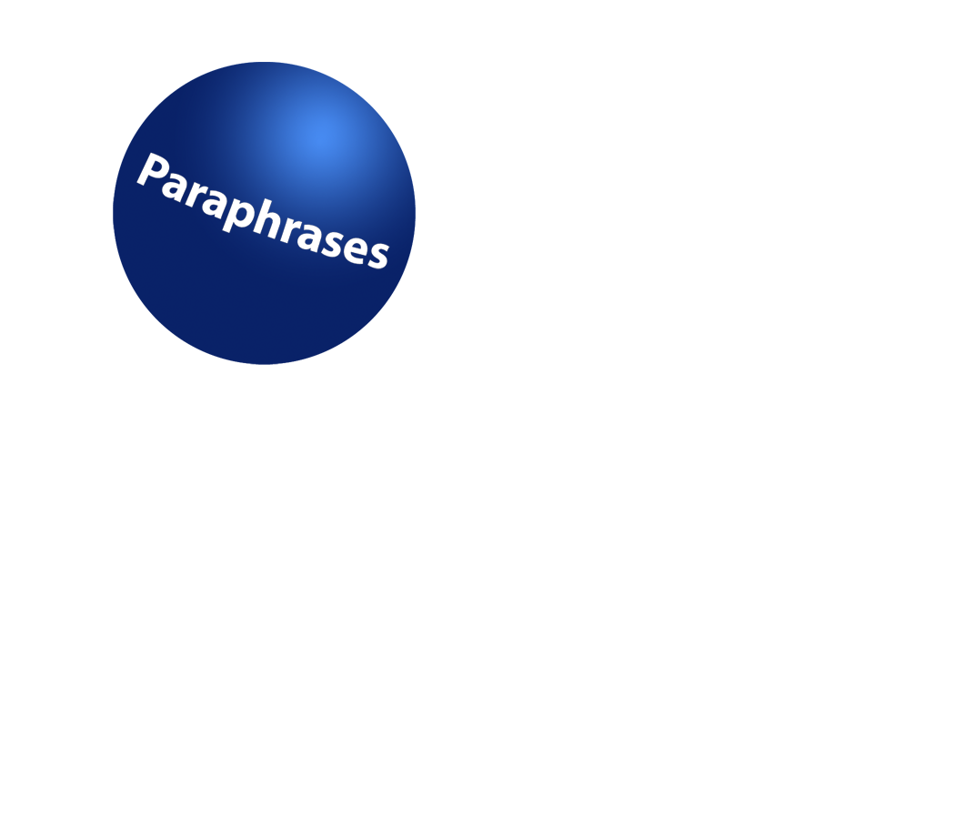



A Learning-focused Toolkit
Attending fully

Slide 5
Attending Fully
Taking time to listen carefully, shape meaning as we speak
Asks for suspension of personal referencing and certainty
We signal our full attention physically
Vocal intonation, pacing, and word choice all communicate how attentive we are

Slide 6

Pausing
Allow time for thinking, elaboration, and framing thoughts and responses
Pace the conversation for thoughtfulness
!!..
??!!

Slide 7

Paraphrasing
Signals listening, determines understanding, supports your partner in clarifying, organizing, extending thinking.

Slide 8
Paraphrasing continued
3 powerful types of paraphrases:
  Acknowledge/clarify (ex. “So, you’re feeling...., You’re noticing....., In other words ...., You’re suggesting ...”)
  Summarize and Organize (ex. “for you, several themes are emerging.., So there seems to be two issues here..’)
  Shifting level of abstraction up or down (ex. So a belief for you might be...., So an example for you might be...”)

Slide 9
Mediational Questioning
Questions that invite inquiry, and open up thinking. These questions help others to explore ideas, issues, concerns, perspectives, and proposals.
Questions which probe to focus thinking and encourage precision. These questions help to clarify vagueness and generalities.
Questions that extend thinking. These questions help others to connect to the bigger picture, to plan what action to take, to reconsider their ideas through a different lens or perspective.

Slide 10
Playing with the Verbal Toolkit
Work in trios.
Think alone: think of a classroom issue, a challenging student, a dilemma of your practice that you are working with at this time.
Person A speaks about this issue and Person B responds using the verbal tools. Person C observes and notes how the tools are evident.
Switch roles after a 5-minute conversation
Debrief the conversations together.

Slide 11
Learning-focused verbal tools
Paraphrasing
Logical levels: Multiple purposes
Acknowledge/clarify—calibrating content and emotions
Summarize/organize—a statement of themes, big ideas, and separation of confusing or jumbled issues
Shift Focus—a shift in logical level, raised to a category or conceptual label, or focused as a concrete example
Pausing
After asking a question
After receiving a response
While you frame your own
language
Learning-focused Verbal Tools
Pause
Paraphrase
Inquire
Probe
Extend
Inquiring
Without judging
Framed in a spirit of professional curiosity
Anticipates multiple possible responses
Invites thinking and meaning making
Extending
Making data available for making discoveries and developing shared understandings.
Giving information
Framing expectations
Providing resources
Probing
When there may be a lack of clarity or precision, in speech or thought, probe specifically regarding:
Who? What? Why? Where? When? How?
From: Laura Lipton and Bruce Wellmann
Mentoring Matters: A Practical Guide to Learning-focused Relationships
First Edition, March 2001, Sherman CT MiraVia, LLC

