Slide 1
Mentorship Survey Results
End of Year 2013

Slide 2
Mentor/Mentee Comparisons
Responses Received:
Mentors = 22/25=88%
Mentees = 17/31=55%

Slide 3
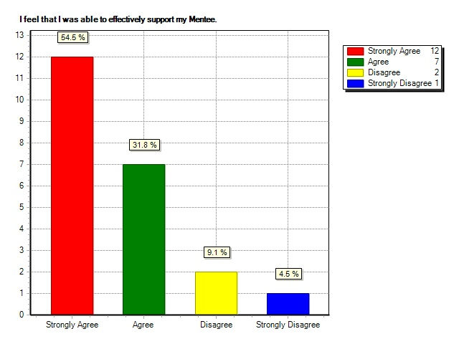
Support Level
Mentees=94% Agree
Mentors=86%
*Main concern was difficulty working with TTOC

Slide 4
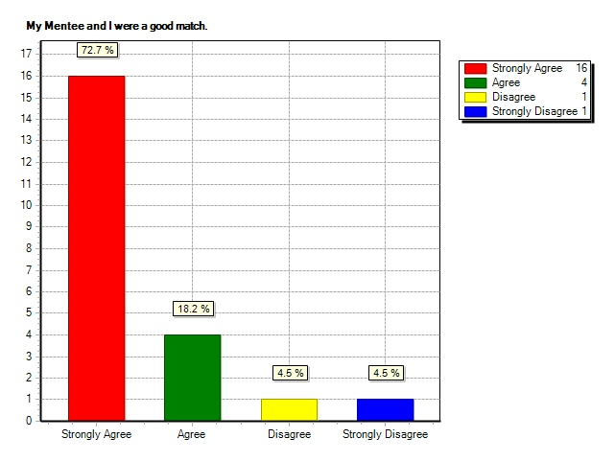
Match between Mentor and Mentee
Mentee = 94%
Mentor = 91%
*Main concerns were distance and TTOC

Slide 5
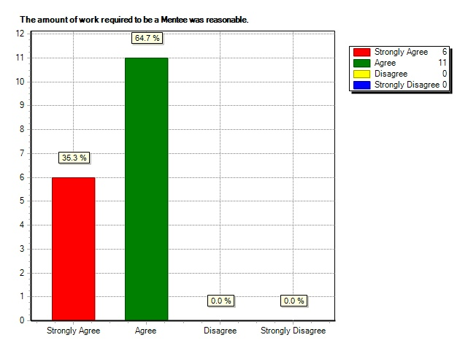
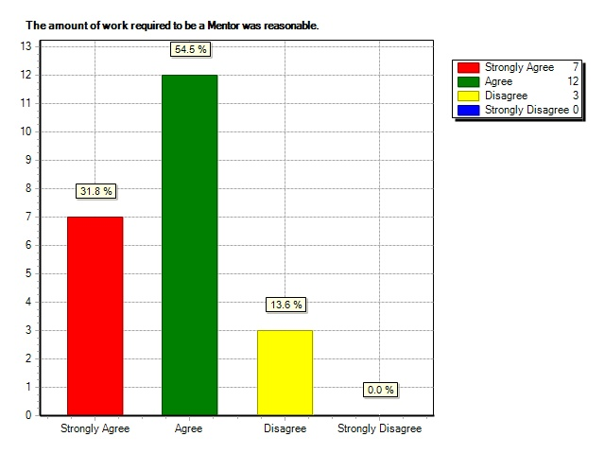
Amount of Work Required
Mentee = 100%
Mentor = 86%
*Main concerns were travel time and time for online contributions

Slide 6
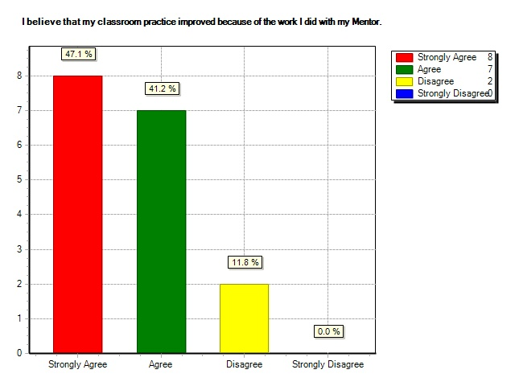
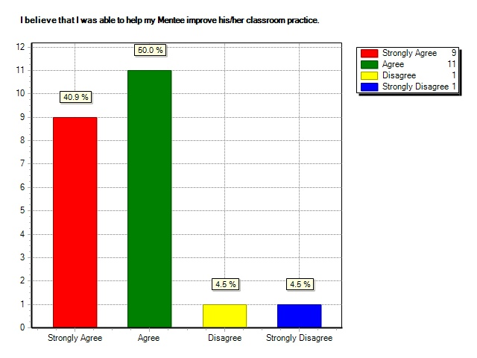
Mentee Classroom Improvement
Mentee = 88%
Mentor = 91%

Slide 7
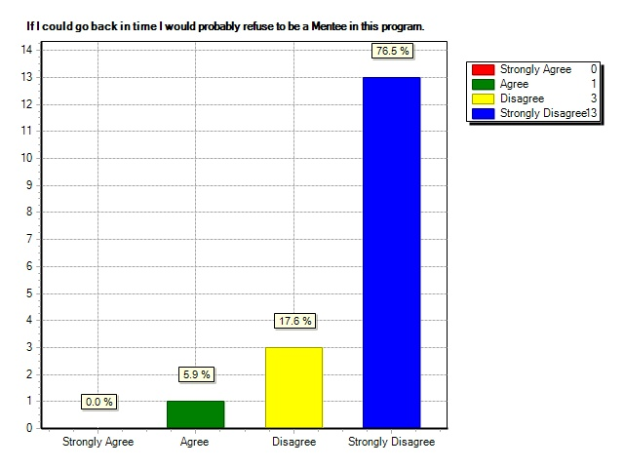
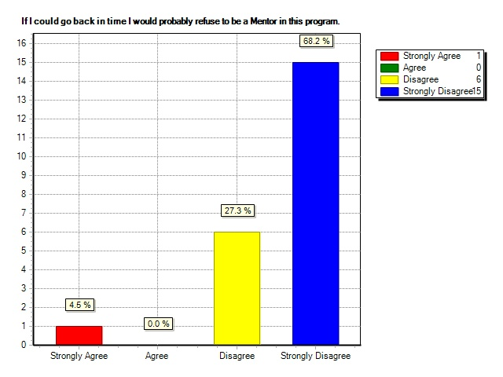
Looking Back
Mentee = 6%
Mentor = 5%
*Main concerns were location and working with TTOC

Slide 8
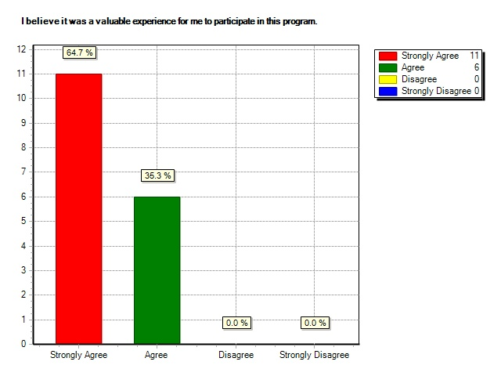
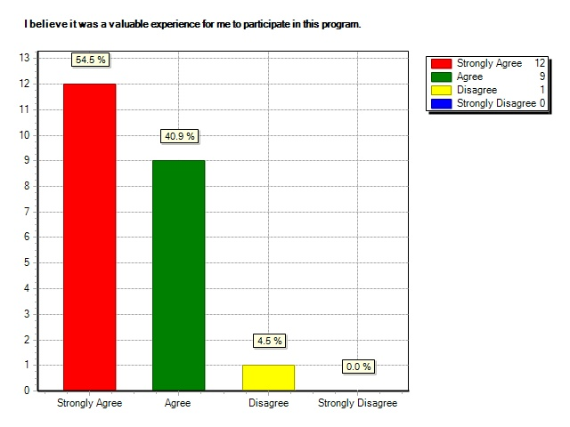
Valuable Experience
Mentee = 100%
Mentor = 95%

Slide 9
What Mentees Learned
As a TTOC I was able to learn quite a lot from my Mentor; I had the opportunity to observe many different classrooms and teaching styles….
I learned that I had unrealistic expectations of myself and how much to take on. I was on my way to burn out if I tried to keep up with the way I was going.
To continue to be reflective and self-critical in my practice. To write down my goals, and actively seek possible solutions to my teaching shortcomings through collaboration.
Keep on trucking and tweaking but remember to teach students not curriculum
…having the opportunity to work with a mentor really helped develop my program, and my confidence in teaching my program.

Slide 10
What Mentors Learned
increased my awareness of the importance of self reflection
helped improve my teaching practice…
To be a good listener
The value of authentic, evolving mentoring
The greatest benefit for me was to collaborate with a very enthusiastic colleague. Very motivating!
There are so many ways to do things that it was an interesting process to work through possibilities.
It made me affirm that what I am doing in the classroom is good practice. Because you have to explain and rationalize what you do in the classroom with your mentee it makes you reflect on what you do and why you it.
I looked at my own teaching practices and felt more effective in my own classroom

Slide 11
Challenges Experienced--Mentees
Taking time away from my classroom
At the start, there was not enough notice for planned events
logistics - we live in different towns
…it was very difficult being a TTOC as a mentee
That my mentor was not in the same role as me
finding time to meet
Coming up with the right questions

Slide 12
Challenges Experienced--Mentors
Time away from the classroom.
Time to meet regularly
A mismatch with mentee
Distance was the most limiting factor
Working with a TTOC and finding opportunities to work with her in a classroom setting

Slide 13
Suggestions to Improve Program--Mentees
don't give one mentor 4 mentees
More meetings between the 2 (mentor and mentees)
I think particularly for specialized fields it is essential that people should be matched with same background that are currently in the position.
More structure from the onset of the program, in terms of different models for mentoring, feedback and goal-setting forms etc.
Include both mentor/mentee in all meetings.
I think the project needs to move towards a more collaborative model. I don't really like the hierarchical nature of the mentor/ mentee dynamic.
I would suggest trying to find experienced ttoc mentors because lots of regular classroom teachers forget what it was like to be in a different classroom each day.
Continue to allow teachers to choose their partners

Slide 14
Suggestions to Improve Program--Mentors
Avoid having to take time away from the classroom. Have the mentee and mentors be in the same school.
More group meetings with other mentees/mentors.
Have local groups meet with a local leader if necessary to meet again - meet later in the year for the first meeting so everyone has met with their mentees a few times
Perhaps a career TTOC would be better as a mentor especially if the teacher mentors have never worked as a TTOC.
Clearer application form so there's no confusion about what you are applying for. The time commitment and the amount of release time that is allowed.
Start early in the school year!
Don't bog mentors down with paperwork.
Although the blog was a good idea, there was no time to do it.

Slide 15
The Year Ahead
Data Gathering:
Mid-point survey
Focus Groups
Final Survey
Questions for discussion:
Other people to be included?
Increasing participation with prizes?

