Slide 1
Developing Mentor Capacity using the Lesson Study Model
Developed by Tashi Kirincic, Coordinator of Teacher Mentorship, Delta School District

Slide 2
Resources
Lesson Study Overview from Center for Advancing Teaching and Learning University of Wisconsin-La Crosse
Lesson Study Process Diagram from Center for Advancing Teaching and Learning University of Wisconsin-La Crosse
“Why Lesson Study?” from theCenter for the Collaborative Classroom (2:41 min)
“Research and Debrief” from the Center for the Collaborative Classroom (3:14 min)

Slide 3
Activity for teacher mentors

Slide 4
Think about times in the past when you were engaged in:
What was the purpose of the experience?
What did it:
look like?
sound like?
feel like?
What did you learn from it?
Being observed
Observing someone else
Co-planning
Co-teaching
Co-reflecting
Record your thoughts
on the left side of the t-chart.
Notes:
Reflection on prev experiences

Slide 5
Choose one word or phrase and write in on the whiteboard.
Write – Don’t Repeat
Notes:
Everyone writes at least one thing on the whiteboard

Slide 6
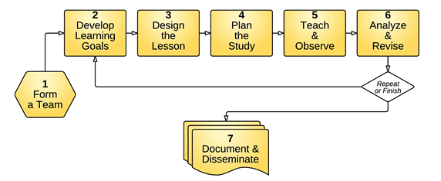
Lesson Study Process
our focus today
Notes:
Overview of lesson study model
Our teams are sort of set- discuss who will participate
Focus will be on steps 2-6

Slide 7
Stages of Lesson Study
Read the information provided for your stage.
Record the key points.
Move to the next stage.
Read the information provided AND what the previous group recorded.
Make any additions/adjustments to the information recorded.
Prepare to share the information with the whole group.

Slide 8
Lesson Study in Action
Why Lesson Study?
Research Lesson and Debrief
How are the experiences represented in these videos different than your previous experiences with observing, being observed and co-planning/teaching/reflecting?
Record your thoughts on the right side of the t-chart provided earlier.
Notes:
Look at questions- watch video- time to record
Watch 2nd video time to record

Slide 9
1. Add something 2. Remove something 3. Change something 4. Add emphasis to something
Look at the whiteboard . . .
. . . to make it reflect the lesson study experience.
Notes:
Everyone makes a contribution

Slide 10
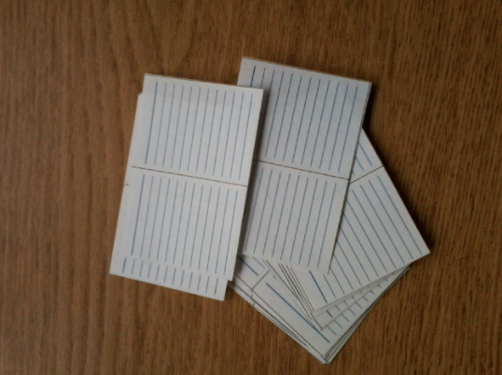
Action Plan
To make co-teaching/planning/reflecting a valuable learning experience for everyone on your team . . .
What do you as mentors need to?
What do you need from the protégés?
Write each idea on a slip of paper.
Notes:
Action plan what do mentors need to do to make this work? What will you need from the protégés? How will you make this happen

Slide 11
Share your cards by taking turns reading them out and placing them in the middle of the table until every card has been shared.
Work together to sort the cards into clusters that make sense to everyone based on the relationships you perceive between the items.
Create a label for each cluster.
Create a synthesizing statement that will serve as your group’s guiding statement for this process.
Notes:
Record synthesizing statements on whiteboard

