Slide 1
Goals and principles
To provide a coherent, research-based and sustainable system of support for teachers in their early years throughout the province
To be responsive to the diversity and distinctiveness of district cultures and practices in all regions of BC
Mentorship is non-evaluative, non-remedial, and participation is voluntary
Participation and organization must demonstrate joint commitment from district administration and local
To reach out to rural educators
To provide professional learning through inquiry and critical reflection on practice.

Slide 2
a BC partnership:

Slide 3
What’s in a penny?
1 minute share: Re-connecting who you are
Something significant that happened in the year of your penny
Notes:
2 groups – volunteer a story with the pennies to share in your group
Share 1-2 stories in large group (Alison participate) Nancy tell her story at the end

Slide 4
WHY ARE WE HERE?
To gain a deeper understanding of mentorship and its significance in our professional lives
To build enthusiasm and a focus for mentorship
To feel better prepared with strategies and skills to build an effective mentoring relationship
To build a community of mentoring professionals across the district

Slide 5
WHAT CAN YOU EXPECT? (content)
Opportunity to explore different perspectives on mentorship
A framework for the mentoring cycle and processes and examples from practice
Strategies and tools to support growth oriented relationships
Establishing goals for professional growth
Planning time to develop an action plan

Slide 6
Creating a responsible environment
Inclusivity: everyone has the right and responsibility to participate
Confidentiality: what is shared stays in the room, what is learned leaves with us
Respect: refrain from internal and external judgment and blame
Feedback: invite and offer honest feedback
Learning: contribute our current understanding, and stay open to what is new

Slide 7
“The [challenge and/or opportunity] for
teachers is negotiating between the fiction of schools and classrooms as rational, predictable spaces and the messy, infinitely complex reality of life in real classrooms.”
(Source: Freidman, A. Al and Reynolds, L., Burned In: Fueling the Fire to Teach, 2011)

Slide 8
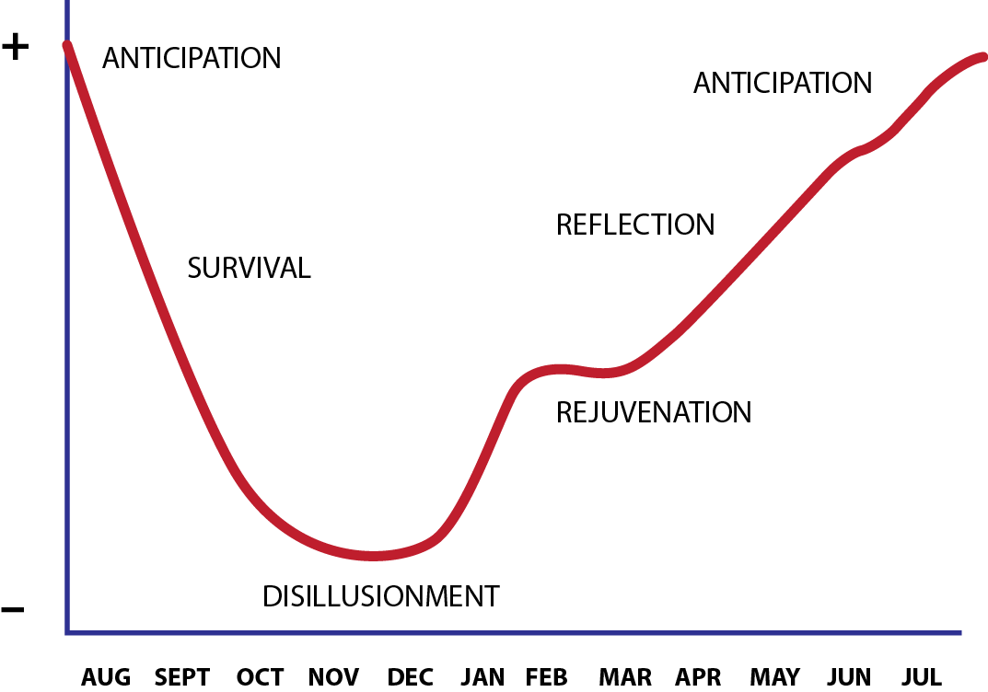

Slide 9
Phases of First Year(s) Teaching (Ellen Moir, Director of Santa Cruz New Teacher Project)

Slide 10
Sharing our teaching work
Please speak about a ‘teaching and learning moment’ from the past week when:
You felt the most connected, engaged or affirmed as a teacher, or...
You felt the most disconnected, disengaged or discouraged.
Notes:
Now lets look into the heart of what makes a great mentor – your stories are the foundation for this process

Slide 11
Models of Teacher Induction (Sharon Feiman-Nemser, 2012)
 | Goals | Components | Outcomes
Induction as Temporary Support | Ease transition into teaching. Reduce stress and address problems of beginning teachers. | Reduce workload. Orientation to school and community. Informal buddy system, offering advice and emotional support. | Teacher survival and retention.

Slide 12
Models of Teacher Induction (Sharon Feiman-Nemser, 2012)
 | Goals | Components | Outcomes
Induction as Individualized Professional Development | Foster new teacher development. Promote more effective teaching and learning for all students. | Orientation to school and community. Reduced workload. Curricular guidance. Serious mentoring for at least two years. Administrative support. | Improved teaching and learning. Teacher satisfaction and retention.

Slide 13
Models of Teacher Induction (Sharon Feiman-Nemser, 2012)
 | Goals | Components | Outcomes
Induction as Cultural Transformation | Reduce teacher isolation. Incorporate new teachers into an integrated school community that supports continuous learning of all teachers. Promote more effective teaching and learning for all students. More equitable schools. | Reduced workload or team teaching assignment. Serious mentoring. Intergenerational learning teams. Administrative involvement. | Continuous learning of all teachers. Collective responsibility for teaching and learning. Quality learning environment for students. Increased student achievement. Rewarding career path for teachers.

Slide 14
What are the key ideas emerging from your conversation about what you value in mentorship for this district/local?

Slide 15
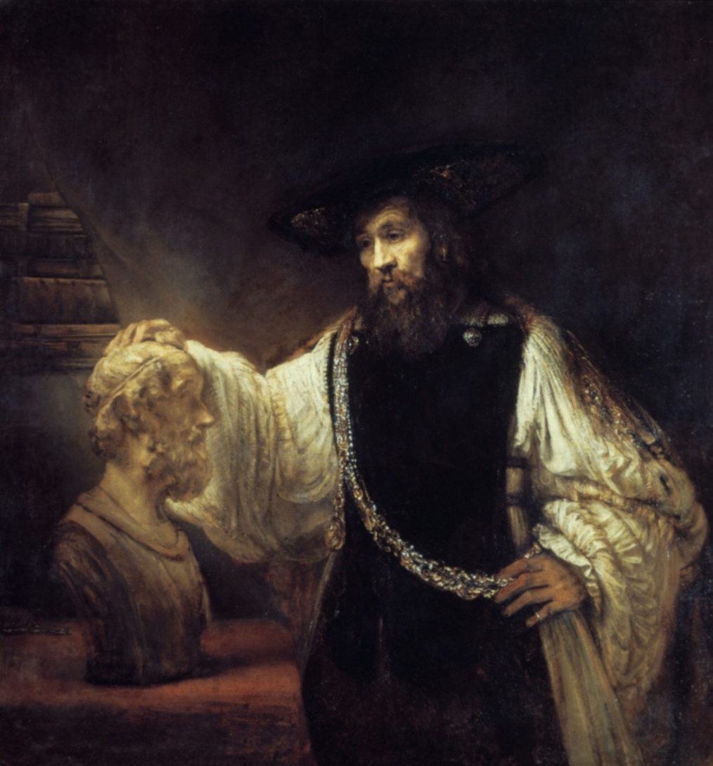
The Story of the Original Mentor
Notes:
'Aristotle contemplates the bust of Homer', Rembrandt

Slide 16
Drew Dudley Everyday Leadership

Slide 17
Solo Write...
Who was an individual who provided real support for you at a critical point in your becoming a teacher, or teaching career?
How did they contribute to your growth and development?
What lesson did you learn from them?
If they were in the room with us right now, what would you want to say to them?

Slide 18
In your groups:
Please synthesize your shared understanding of mentorship on a chart:
Mentoring is ...
Mentoring is not ...

Slide 19
Laurent Daloz
“We need other people to show us, to accompany us, to hold the hope and steady our faith that we will make it. And we also need people with whom to practice… For in relationships, we both form and heal what we come again and again to name our self. This is why mentors and mentoring environments play such a key role. Without adequate support many learners...may decide to stay where they are.”

Slide 20
Effective mentoring
Process is dynamic and reciprocal
Mentor as facilitator, not teacher
Driven by goals of the mentee
Built on trust and shared understanding of the context of each other’s work
Focused on educational change and innovation
Inquiry focused

Slide 21
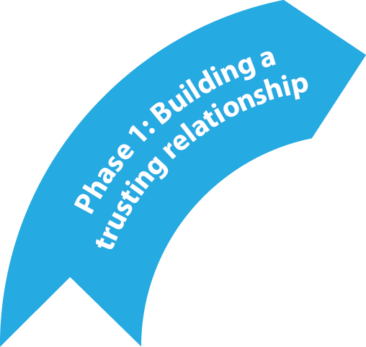
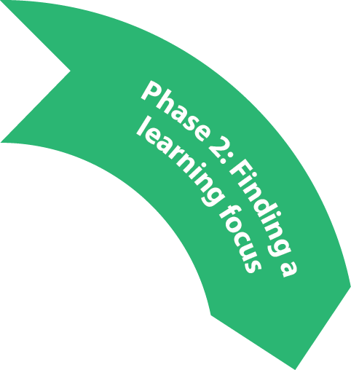
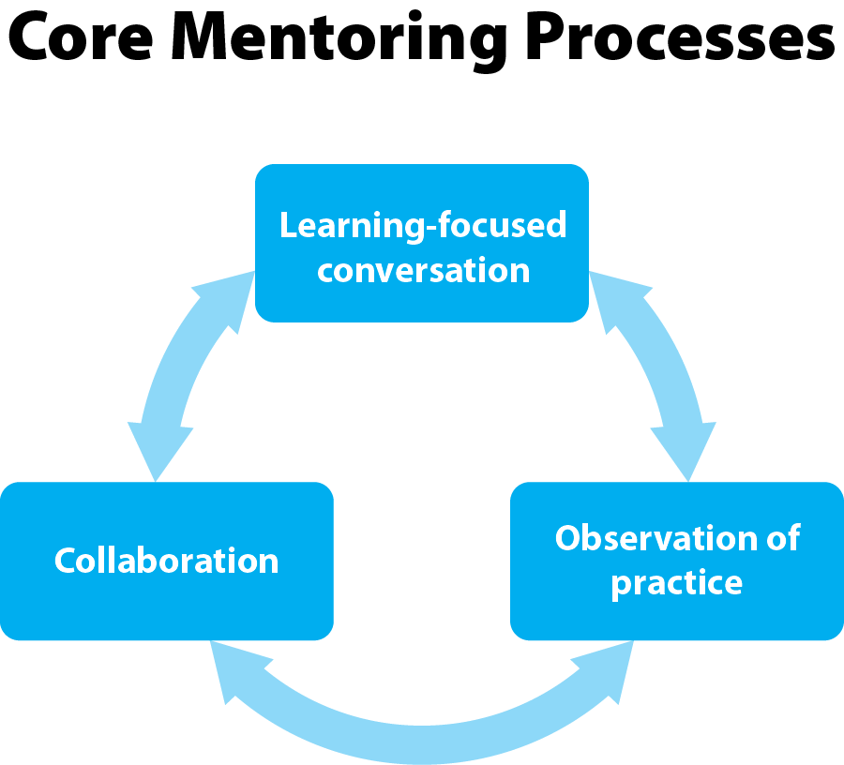

Slide 22
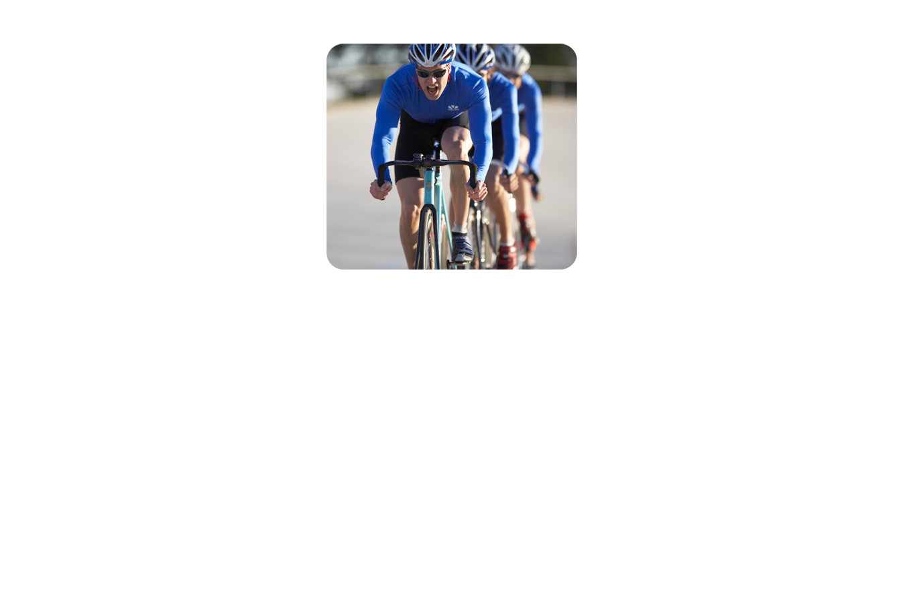
Continuum of Mentor Roles
Consult
When the mentor draws upon her/his own experiences and expertise to offer perspectives and options.
Collaborate
Participating together in planning, reflecting, problem-solving. Generating ideas together.
Coach
Mentor supports his/her colleagues thinking.

Slide 23
Learning-focused conversations
confirm, clarify and extend thinking
help us to hear ourselves and others more accurately
ask for full attentive presence to each other
allow us to listen attentively to multiple expressions of feeling and thought
help to frame problems rather than offer solutions.

Slide 24
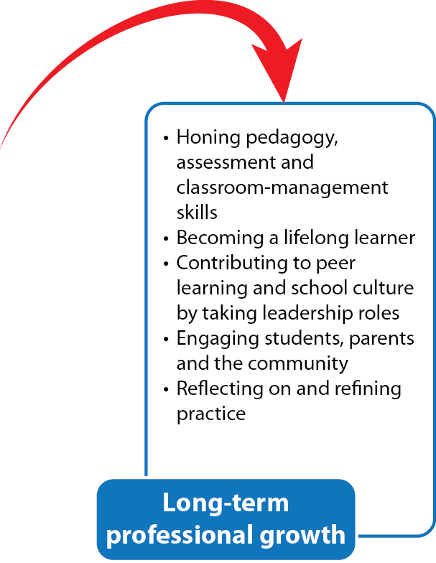
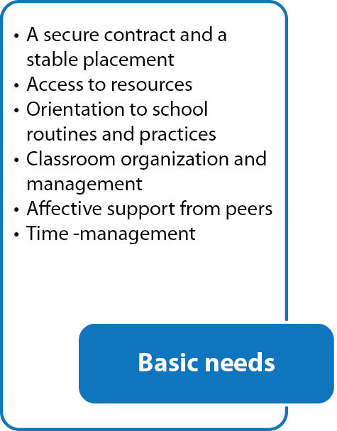
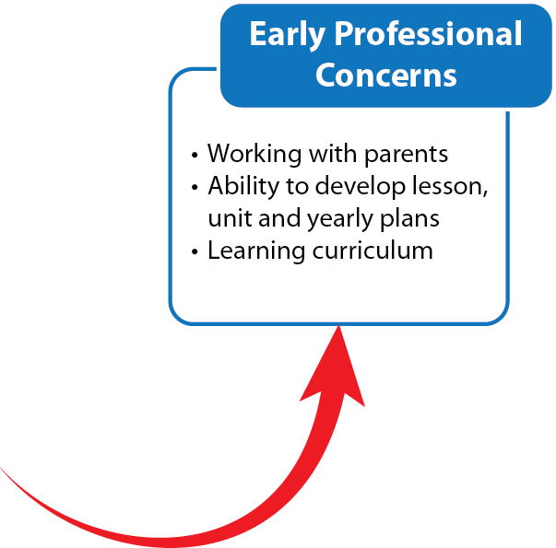
Evolving Professional Development Needs

Slide 25
As we think about Day 2...
Please read the article, Boomers and Millennials: Vive La Difference sometime between now and 9:00 tomorrow morning!
Strategy – the 3 A’s
One thing you AGREE with
One thing you can ARGUE with
one AHA!

Slide 26
Levels of Conversation
monologue
transaction
interaction
collaborative engagement
dialogue
learning
Trust

Slide 27
Actionable goals ....
Represent a challenge, stretch or reasonable risk
Grounded in pedagogical purpose
Focuses on what’s important to the teacher
Is specific, concrete, and clear
Will result in evidence that can be seen, heard, or demonstrated
Requires more than one strategy in order to achieve it

Slide 28
SMART Goals
Support | Understand the context Affirm strengths Create a safe place | “Let’s talk about what you have already done to help with this goal...”
Motivate | Focus on possibilities by sharing your own and others success stories Offer a roadmap | “What skills and talents can you build on?” “Describe what it will look like and feel like when ....”
Align | Align goals with personal values and purpose. | “How will this goal help you feel more competent?”
Reframe | Suggest alternate ways of looking at problems and possibilities Set up scenarios | “What would happen if..?” “What else might you try?”
Take time to talk about time | Determine the goal is achievable within a time frame to make an immediate difference | “Is this the right goal for right now?” “Is the timeframe realistic for you? “

Slide 29
T he essential stance of a mentor is one which builds capacity in others.
Mentor interactions balance three functions:
offering support
creating challenge
facilitating professional vision
(Laurent Daloz, 1998)
It is through attentive listening and practice that we discern which interactions within this moment, with this person, will most help to build capacity.

Slide 30
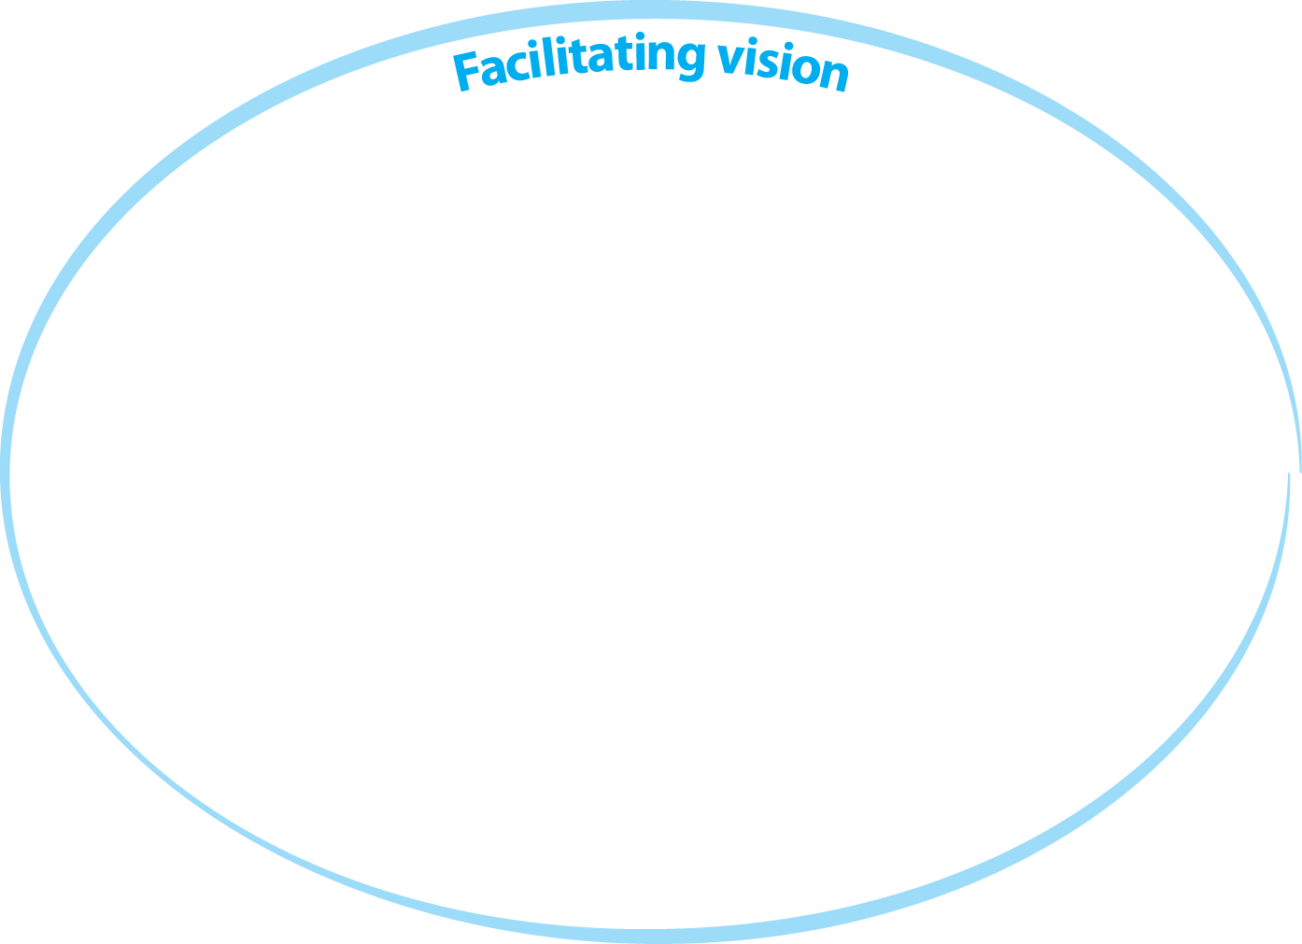

Slide 31
Offering support
Attending fully
Acknowledging complexity
Creating a ‘safe’ place
Offering resources
Guiding through procedures and school practices

Slide 32
Creating challenge
Engaging in goal setting
Probing and analysis of practice
Exploring student work
Problem-solving
Posing inquiry questions
Building connections between theory and practice

Slide 33
Engaging with teacher criteria for growth
Co-designing with the end in mind
Developing action plans
Encouraging collaborative opportunities
Modelling teaching practices

Slide 34
Mentee case studies
Where do you think this person is on the matrix?
What strengths can you build on to offer support?
What are the possible challenges that would move this teacher towards growth?
How might you facilitate vision and maintain professional growth?

